Slide 1
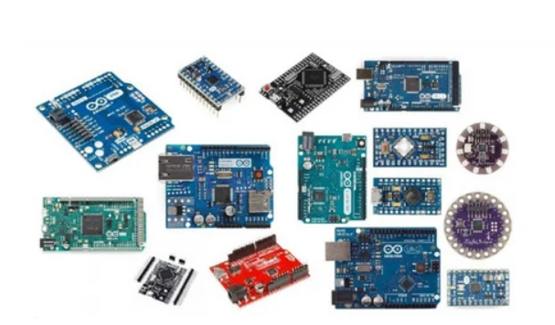
UNIT 2
Getting Started
with Arduino
From understanding the board to writing code that controls real hardware
Prepared by Eng. Theogene NAYIGIZIKI www.nedu.rw

Slide 2
Unit 2 at a glance
The goal is to move from theory to practical control of hardware.
2.1 Arduino boards
2.2 Arduino IDE
2.3 Sketch structure
Recognize the board, its main parts and common board families.
Install the software, select the board and choose the correct port.
Understand setup(), loop(), and how timing works.
2.4 Digital I/O
Practical checkpoint
Read a push-button and use it to switch an LED.
Build, upload, test and explain a simple circuit.
By the end, learners should be able to identify an Arduino board, configure the IDE, explain a sketch and control an LED with a button.
2

Slide 3
Learning outcomes
After this unit, you should be able to:
Identify the main parts of an Arduino board and name common board families.
Install and configure the Arduino IDE.
Explain the purpose of setup() and loop().
Write and upload a program that blinks an LED.
Read a push-button with digitalRead() and control an LED using a condition.
3

Slide 4
2.1 Arduino boards and the ecosystem
Arduino combines a development board, programming software and libraries.
Arduino Uno
A common beginner board with a large learning community.
Arduino Nano
Compact size; useful when space is limited.
Arduino Mega
More I/O pins for projects with many sensors and actuators.
Choose a board based on required pins, size, memory, connectivity and project needs.
4

Slide 5
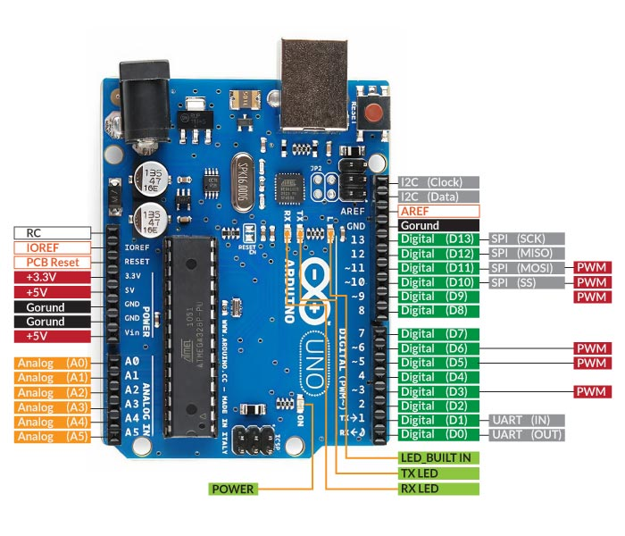
Meet the Arduino Uno
Use the labels on the board to locate power, USB, digital pins and analog inputs.
Digital pins: 0–13
14 digital pins for reading or controlling HIGH/LOW signals.
PWM pins: 6
Pins marked with ~ can provide PWM output.
Analog inputs: A0–A5
Six analog input pins; on Uno R3 these can also be used as digital I/O.
Counting note: 14 digital + 6 analog-capable pins = 20 I/O-capable pins. The analog pins are the same physical pins when used digitally—not extra pins.
5

Slide 6
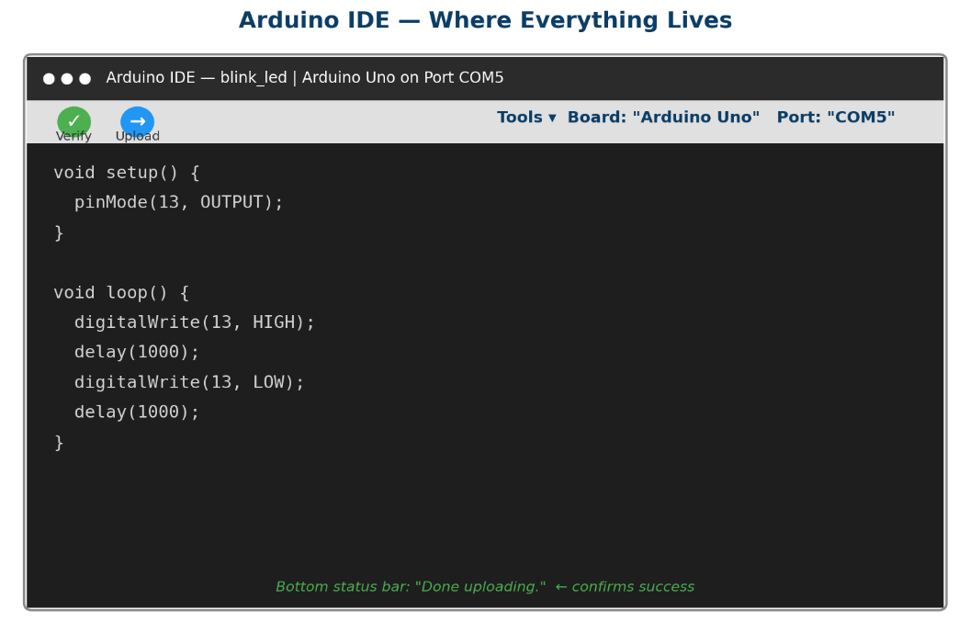
2.2 Install and configure the Arduino IDE
Follow the steps in order before trying to upload a sketch.
Download the IDE from arduino.cc/en/software and install it.
Connect the board to the computer with a suitable USB cable.
Choose Tools → Board → Arduino Uno (or the exact board you use).
Choose Tools → Port and select the port that appears for the connected board.
Click Verify to compile; click Upload to send the sketch to the board.
6

Slide 7
If upload fails: check these first
Do not assume every upload problem is a code problem.
1. Board selection
2. Port selection
3. Cable and driver
Confirm that the selected board matches the hardware connected.
Reconnect the USB cable and check Tools → Port again.
Try a data-capable USB cable and check whether the computer detects the board.
4. Close Serial Monitor
5. Read the error
A serial connection may need to be closed before upload.
Use the exact error message to guide the next check.
Tip: select the correct board and port before changing working code.
7

Slide 8
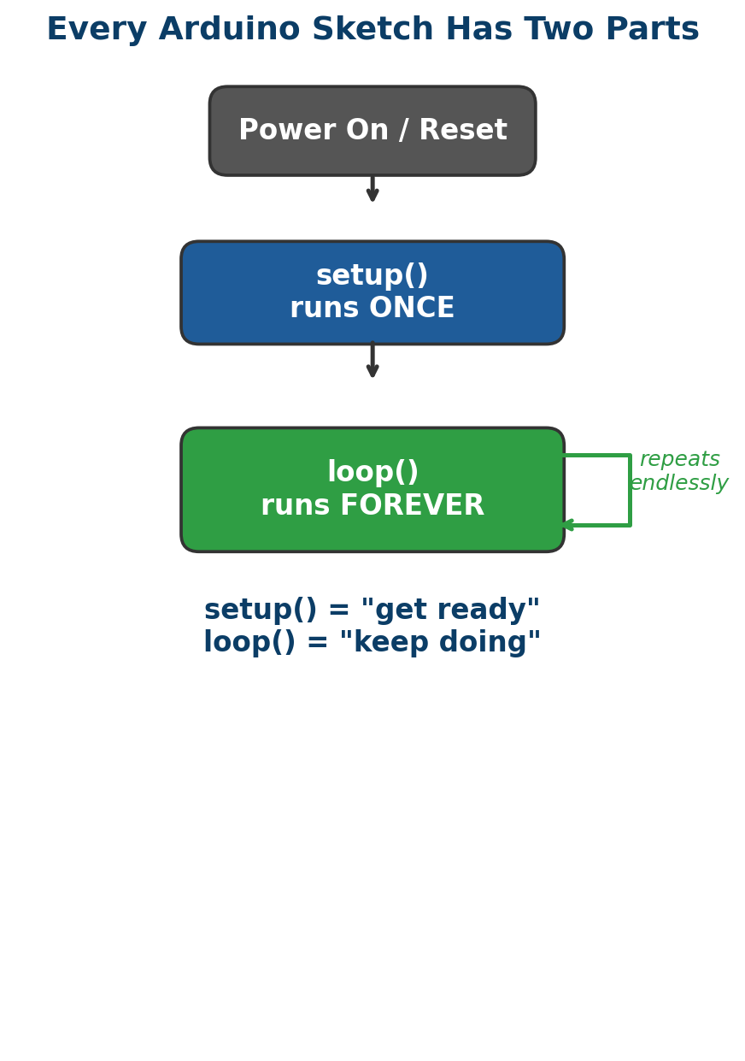
2.3 Arduino sketch: setup() and loop()
Most beginner sketches use these two main functions.
setup() — runs once
Runs after power-up or reset. Use it to set pin modes and start services such as Serial.
loop() — repeats
After setup() finishes, loop() runs repeatedly while the board is powered.
Easy memory aid: setup() = prepare; loop() = keep doing the task.
8

Slide 9
Example 1: Blink an LED
This example uses the built-in LED on many Arduino Uno boards (pin 13).
const int ledPin = 13;
void setup() {
pinMode(ledPin, OUTPUT);
}
void loop() {
digitalWrite(ledPin, HIGH);
delay(1000);
digitalWrite(ledPin, LOW);
delay(1000);
}
pinMode()
Sets the pin as an output.
digitalWrite()
HIGH turns the output on; LOW turns it off.
delay(1000)
Pauses for 1,000 milliseconds = 1 second.
Use a 220 Ω resistor with an external LED.
9

Slide 10
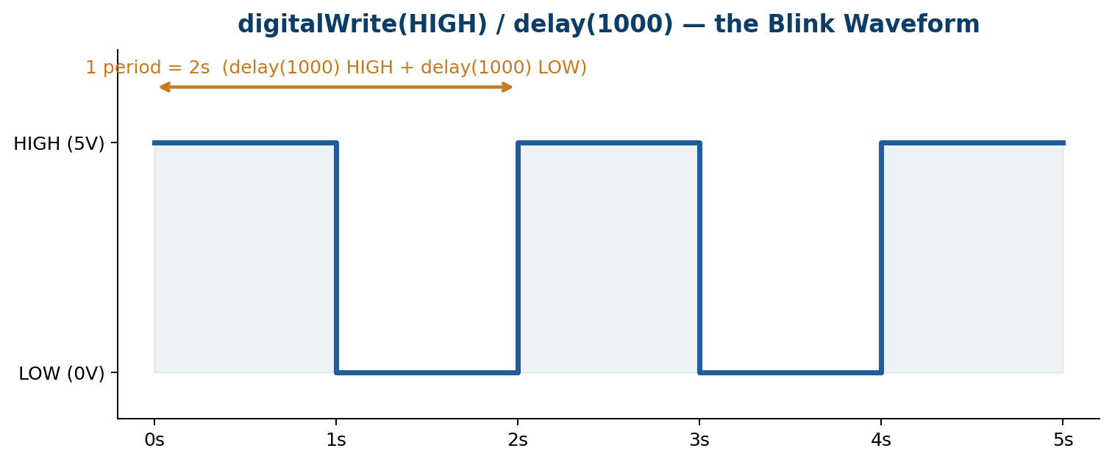
Timing the blink
A full cycle includes both the ON time and the OFF time.
Period
1,000 ms ON + 1,000 ms OFF = 2,000 ms = 2 s.
Blinks per minute
60 seconds ÷ 2 seconds per cycle = 30 blinks/minute.
Frequency
f = 1 ÷ T = 1 ÷ 2 s = 0.5 Hz.
Practice: if ON = 250 ms and OFF = 250 ms, the period is 0.5 s and the rate is 120 blinks/minute.
10

Slide 11
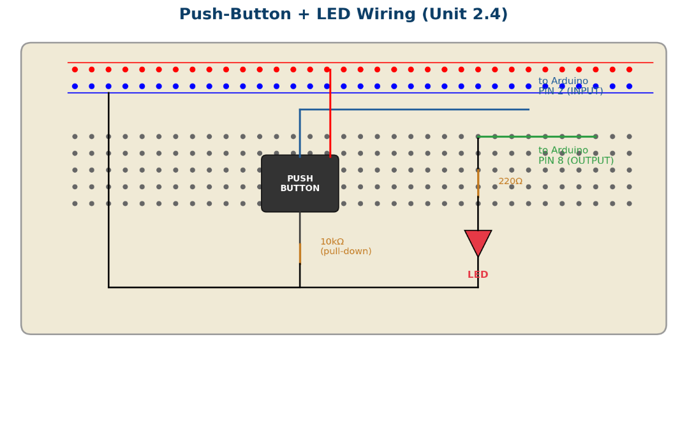
2.4 Digital input and output
The button is an input; the LED is an output.
Input: pin 2
digitalRead(2) checks whether the button signal is HIGH or LOW.
Output: pin 8
digitalWrite(8, HIGH) turns the external LED on.
Circuit safety
Use a current-limiting resistor for the LED and a defined logic level for the button.
11

Slide 12
Example 2: Button controls an LED
This version uses an external 10 kΩ pull-down resistor and works on a classic Uno.
const int buttonPin = 2;
const int ledPin = 8;
void setup() {
pinMode(buttonPin, INPUT);
pinMode(ledPin, OUTPUT);
}
void loop() {
int buttonState = digitalRead(buttonPin);
if (buttonState == HIGH) {
digitalWrite(ledPin, HIGH);
} else {
digitalWrite(ledPin, LOW);
}
}
When pressed
The button connects pin 2 to 5 V, so the input reads HIGH.
When released
The 10 kΩ pull-down connects pin 2 to GND, so it reads LOW.
Correction: INPUT_PULLDOWN is not supported on the classic Arduino Uno. Use INPUT with an external pull-down, or use INPUT_PULLUP with reversed logic and wiring.
12

Slide 13
Why the pull-down resistor matters
It prevents a floating input and gives the button a predictable idle state.
Without a pull-down
With a 10 kΩ pull-down
When the button is open, the input can float and may randomly read HIGH or LOW.
The input is held near 0 V when the button is not pressed.
Current calculation
Correct wiring
I = V ÷ R = 5 V ÷ 10,000 Ω = 0.0005 A = 0.5 mA.
Button from 5 V to input pin; 10 kΩ resistor from the input pin to GND.
The 0.5 mA calculation assumes the button is pressed and the pull-down resistor is connected between the input node and GND.
13

Slide 14
Practical activity: build and test
Work in pairs, then explain how the circuit and code work.
Gather: Arduino Uno (or compatible), USB data cable, computer with IDE, breadboard, jumper wires, LED, 220 Ω resistor, push-button and 10 kΩ resistor.
Build the button circuit with the input on pin 2 and LED output on pin 8.
Type the sketch, verify it, select the correct board and port, then upload.
Test both states: button released and button pressed.
Record one problem you met, how you found the cause, and how you fixed it.
Expected result: LED OFF when the button is released; LED ON while the button is pressed.
14

Slide 15
Unit 2 checkpoint
What have you learned?
Board
Software
Code
Identify USB, power, digital pins and analog inputs.
Install IDE; select board and port; verify and upload.
Explain setup(), loop(), HIGH, LOW and delay().
Input
Output
Explain why a button input needs a defined state.
Use a digital output to control an LED.
Next unit: apply the same idea to sensors such as light, temperature or motion.
15

Slide 16
SHOW QUESTIONS
Part A — True or False
True / False 1
True / False 4
1. The setup() function runs once after power-up or reset. (T / F)
4. The Verify button uploads a sketch directly to the board. (T / F)
True / False 2
True / False 5
2. The loop() function repeats while the board is running. (T / F)
5. A pull-down resistor helps prevent a button input from floating. (T / F)
True / False 3
3. Arduino Uno has 14 digital pins numbered 0–13. (T / F)
Part B — Multiple Choice
6. Which function repeats continuously?
9. What is the period for 500 ms ON + 500 ms OFF?
A. start() B. loop() C. setup() D. stop()
A. 0.5 s B. 1 s C. 2 s D. 60 s
7. Which IDE action compiles/checks the sketch?
10. What does a 10 kΩ pull-down resistor do?
A. Verify B. Port C. Board D. Reset
A. Stores code B. Holds input LOW when released C. Powers USB D. Increases clock speed
8. Which pin group includes A0–A5 on Uno R3?
A. USB pins B. Analog inputs C. PWM only D. Power pins
Answer all questions. Be prepared to explain your choices.

